Slide 1


1
MECHA
Manufacturing E-Checksheet Application
Anang Ma’ruf
Bani Salam
DM2260926
250-Maintenance
DM2260929
510-Stamping
Back End Developer
Front End Developer

Slide 2














Digitizing checksheet material production lot control according to user needs
Easy for NG Products Tracking and Data Input by Digital Material Lot Control System
DETAIL SYSTEM
MECHA
BF-43 TR
2
Line 1
input the data directly after the lot number is entered.
Line 2
all lot numbers are drawn up at the end of the shift.
CURRENT CONDITION
STANDARD
PROPOSAL
Way Of Thinking
PURPOSE
Efficient operation
and
Good Traceability
wrong input
Input Time
All lines have the same process to input lot number
Digitalize the material lot control check sheet (input, process, data record)
Difficult to tracing the history of the lot number used.
Write on the check sheet is time consuming
up to 20 seconds for 6 items
Some lines have different ways of inputting data
not standardized
Simple and
Easy To Input
data and search History
Risk of lot number input error due to human error.
=
Tracing the
History
Not
standardized
Make a checksheet that can be used by every line.
Input lot number at the same time when insert material to machine
GOALS
TARGET
PLANNING
ACTIVITY
Grouping and filtering to make it easy to trace the lot number
0 data fault risk by auto input of several data
SPEC ANALYSIS
TRIAL AND IMPLEMENTATION
10-20 July
31 July-2 August
Digitizing checksheet material lot control checksheet according to user needs
Reduce time for data input (2 items)
Standardization process of material lot control
DEVELOPMENT
PRESENTATION
10 July-1 August
27 July-4 August
All lines have the same process to input lot number

Slide 3
Digitizing checksheet material production lot control according to user needs
DETAIL SYSTEM
BF-43 TR
MECHA
2
Easy for NG Products Tracking and Data Input by Digital Material Lot Control System
CURRENT CONDITION
STANDARD
PROPOSAL
PURPOSE
Way Of Thinking
Efficient operation
and
Good Traceability
Wrong Data
Input Time
Tracing the history on stacked papers
Some lines have different ways of inputting data
All lines have the same process to input lot number
Digitalize the material lot control check sheet (input, process, data record)
need
up to 20 seconds for 6 items
Caused by human error.
Tracing the
History
Not
standardized
=
Simple and
Easy To Input
data and search History
Input lot number at the same time when insert material to machine
Make a checksheet that can be used by every line.
Line 1 input the data directly
Line 2 drawn up at the end of the shift.
GOALS
TARGET
TIMELINE
ACTIVITY
Grouping and filtering to make it easy to trace the lot number
0 data fault risk by auto input of several data
SPEC ANALYSIS
TRIAL AND IMPLEMENTATION
Unfinished
Longer programming time, unsupported device
10-20 July
31 July-2 August
Digitizing checksheet material lot control checksheet according to user needs
Reduce time for data input (2 items)
Standardization process of material lot control
DEVELOPMENT
PRESENTATION
10 July-1 August
27 July-4 August
All lines have the same process to input lot number

Slide 4



















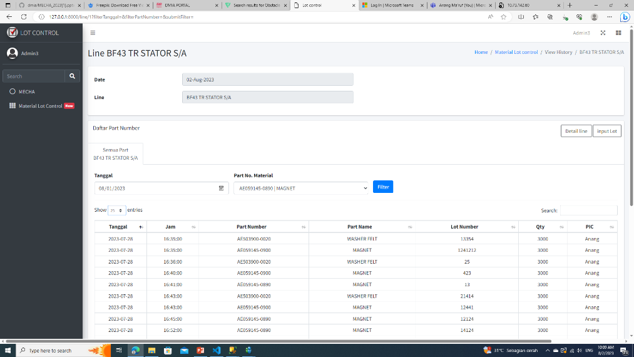
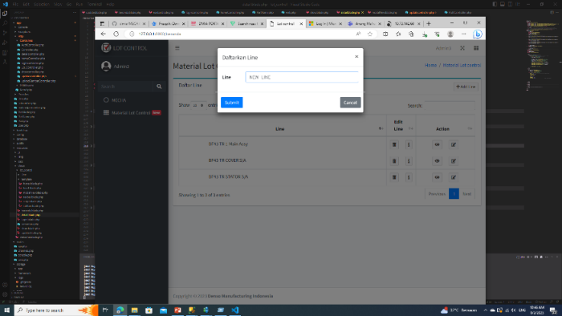
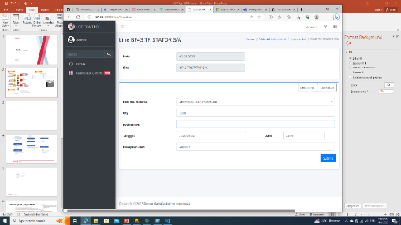

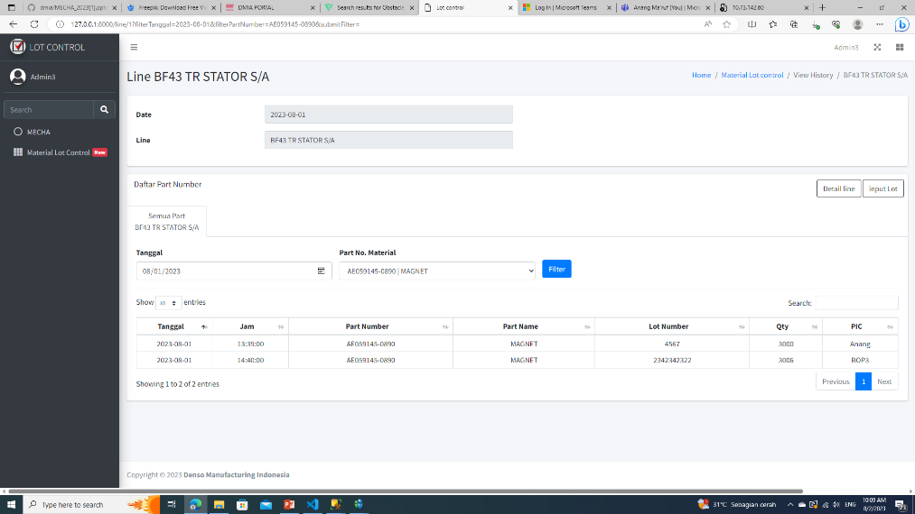
DETAIL SYSTEM
3
SYSTEM COMPARISON
BEFORE
AFTER
STRUGGLE
TOOLS
PREPARATION
IDEAL CONDITION
Input by scan to get part number & lot number
PREPARATION
Prepare Check sheet, distribute, pen.
Provide a connected device to server
DIGITAL
}
ACTUAL CONDITION
INPUT
Most Lot numbers don’t have QR code
QR doesn’t contain Lot number
Up to 6 items. Index, Date, Hour, Lot Number, QTY, PIC
INPUT
2 items
(Lot Number, Hour)
PROBLEM
Make a summary that has same format with paper check sheet
TRACKING
TRACKING
=
Searching on stacked papers
One date separated on different papers
PAPER
collected in one place.
Filter and Search to reduce searching time.
Some Lines have different summary because different check sheet formats
FEATURES
1
2
FILTER SEARCHING
CAN BE USED BY ALL LINES
AUTO INPUT DATA
some lines has different format.
some lines has different format.
Make a website that compatible with all lines
PROBLEM
STRUGGLE
Make a website that compatible with all lines
Make a system that every line can use it

Slide 5
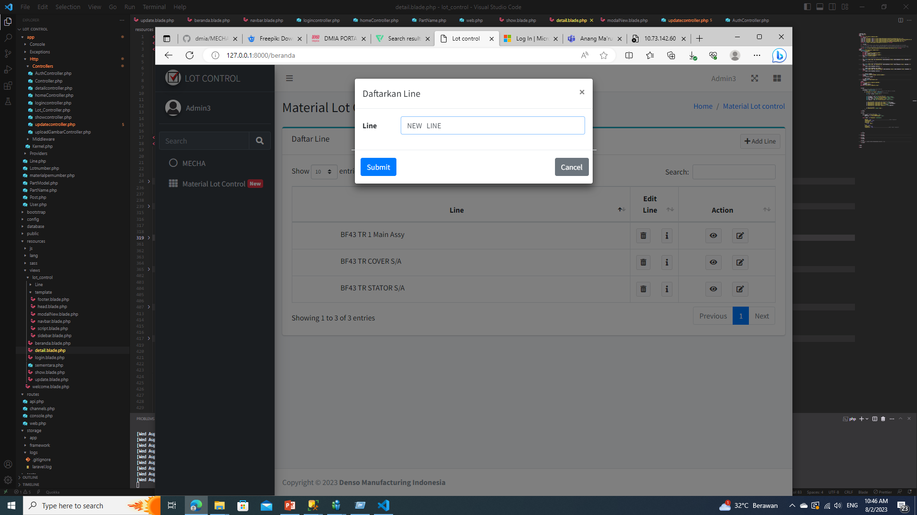
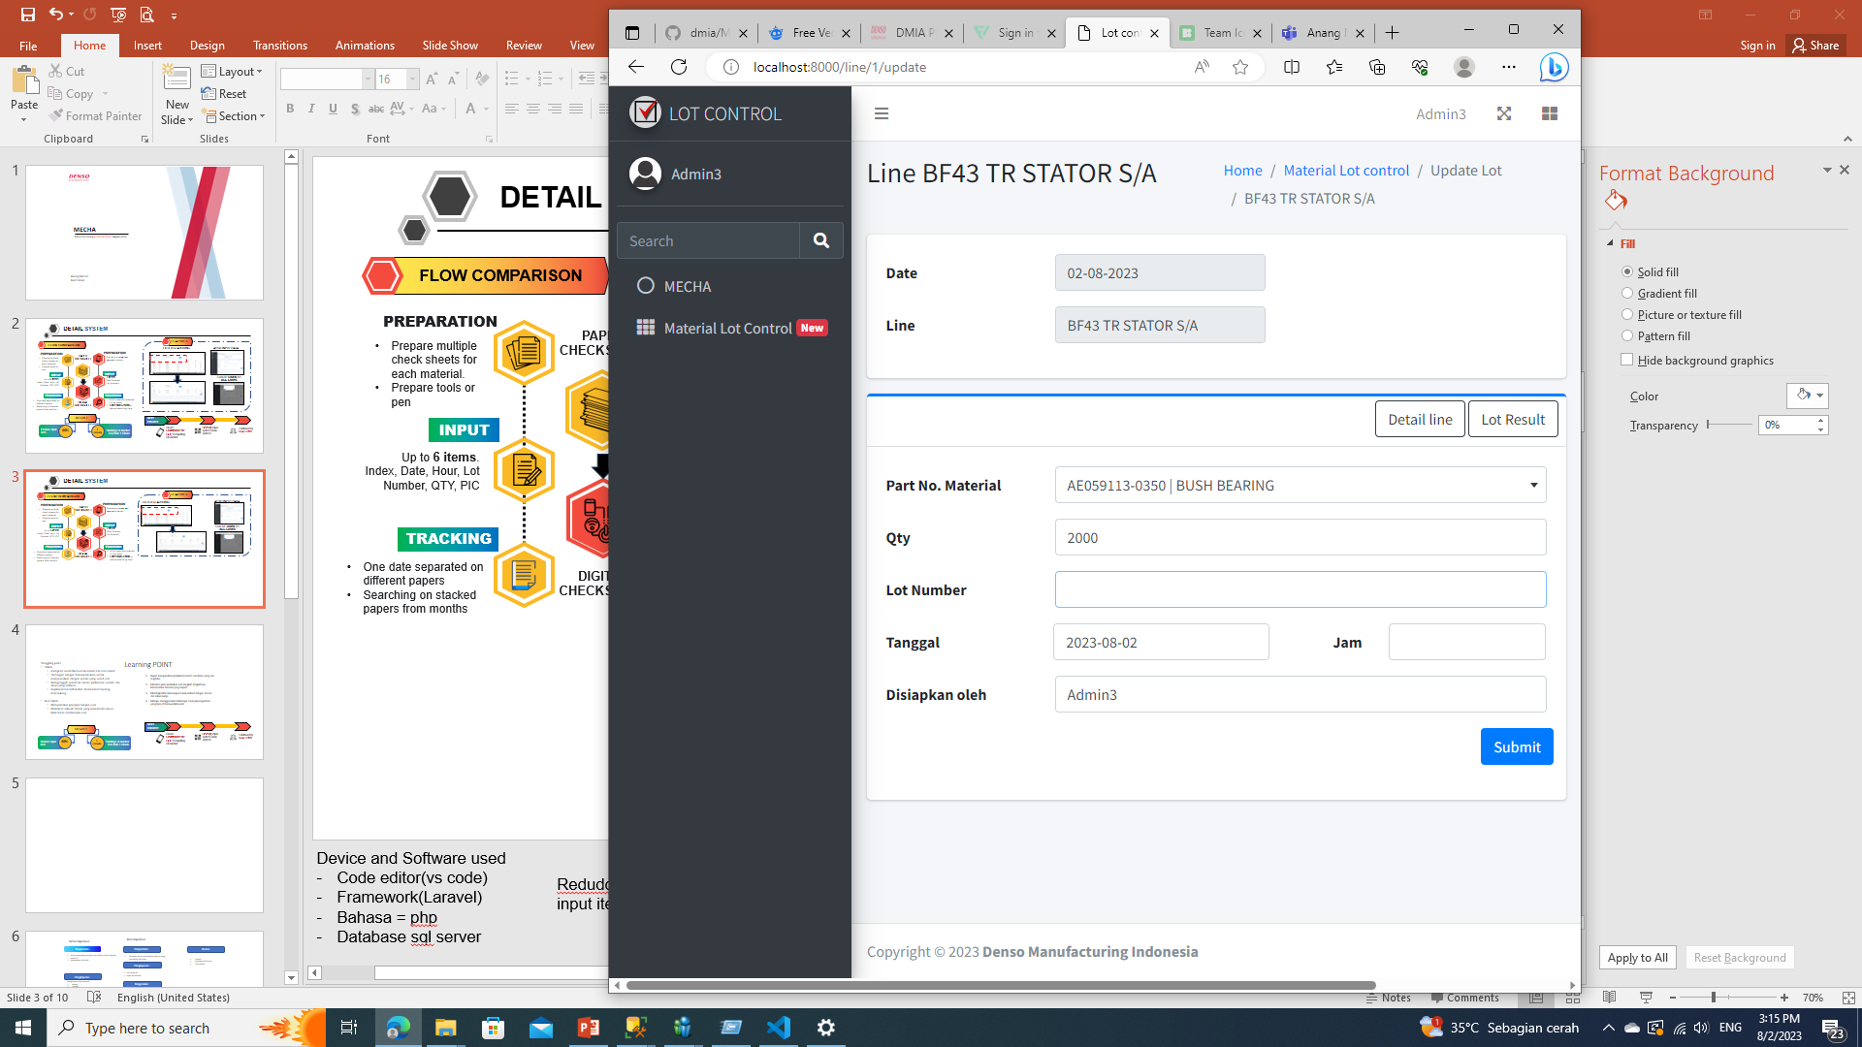

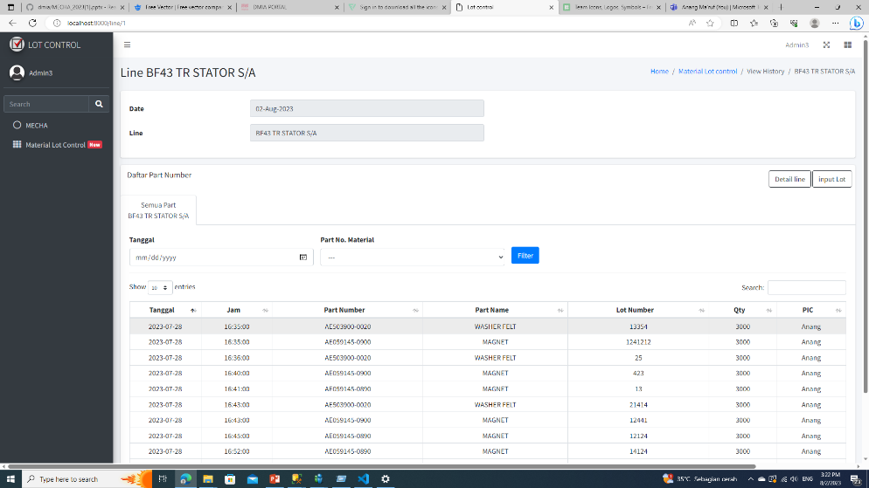

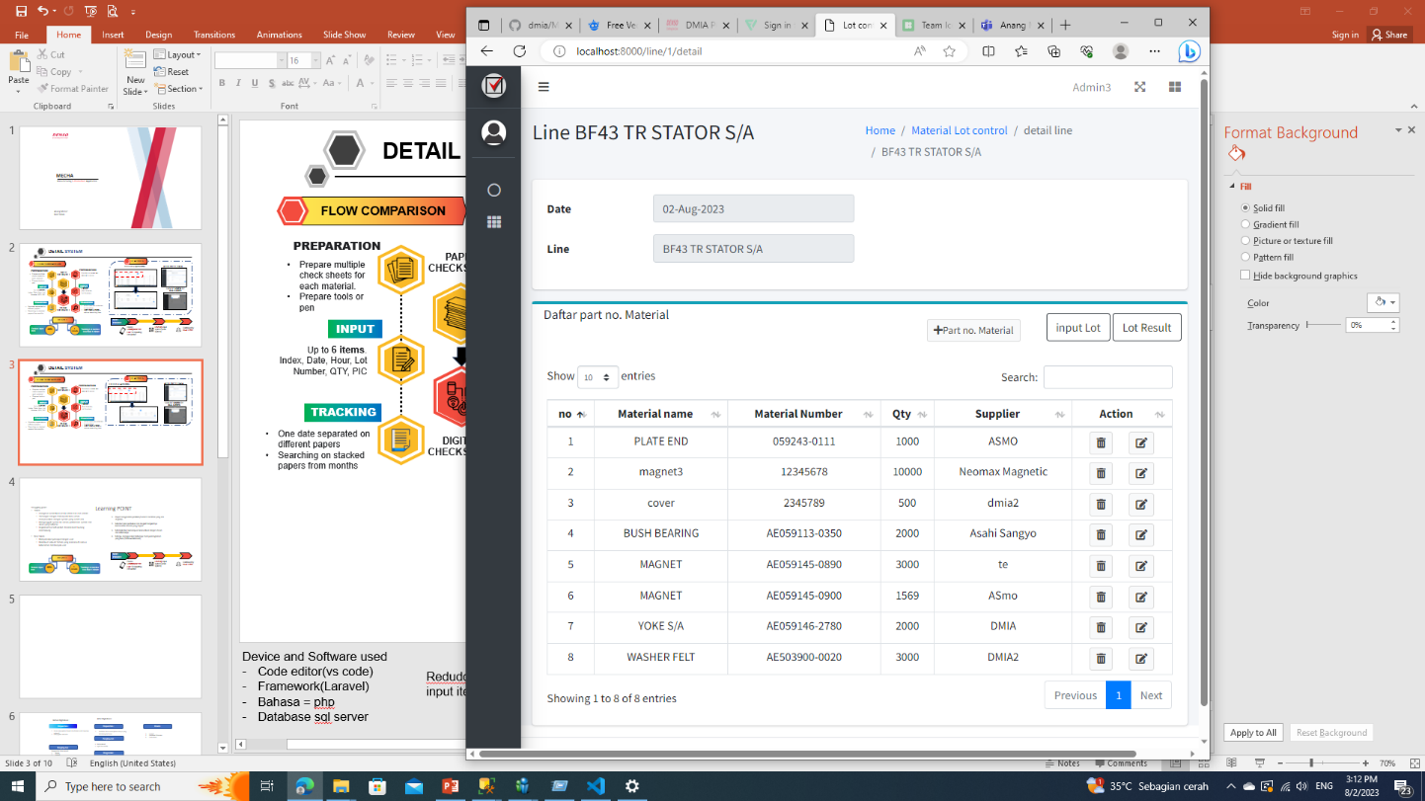

Tracking Lot number less than 1 minute
RESULT
4
WEB RESULT
NEXT PLAN
INPUT LOT FORM
IMPLEMENTATION
Need a Smartphone device for BOP for input lot number directly
LOT RESULT
DEVELOPMENT
Develop scan system for faster data input
Will be continued by BF43 Team
*Input lot by typing
SETTING PAGE
RESULT
6
ITEMS
2
Reduce
STANDARD FLOW
INPUT SYSTEM
TYPING
60%
BEFORE
AFTER
Bop carry a smartphone
Insert Materials into Machine
60%
DATA ACCURACY
95 %
Failure chance = error typing
AFTER IPROVEMENT
Time needed is
less than
Done
Input Lot Number
TRACING LOT
1
minute
NEXT
PROJECT
*Setting page only available for admin
Current result need an improvement to become better
AFTER

Slide 6





analyze the current problems and conditions that are happening to the user
LEARNING POINT
Struggling point
Teknis
mengatur autentikasi untuk admin dan non admin
Tantangan dengan framework baru untuk menyesuaikan dengan system yang sudah ada
Mengunggah system ke server, perbedaan system dan akses yang terbatas
Implementasi terhambat. Environment kurang mendukung
Non teknis
Menyamakan presepsi dengan user
Membuat sebuah Sistem yang memenuhi semua kebutuhan dari banyak user
Analyze the problems and current conditions that are happening to the user
Be able to use the new programming tool, Laravel and its system
Make an improvement plan or concept correctly
Dapat menganalisis problem/current condition yang ada di genba.
Membut plan perbaikan dan langkah langkahnya berdasarkan kondisi yang terjadi
Meningkatkan kemampuan komunikasi dengan atasan dan rekan kerja.
Mampu menggunakan beberapa tools pemrograman yang baru (frameworklaravel)
Improve communication skill with sub coordinate and user
MAKE A GOOD PLAN FOR A PROJECT
Membuat sebuah website Checksheet yang sangat sesuai dengan ekspetasi semua calon user.
Penggunaan Bahasa pemrograman Laravel dimana kita harus menyesuaikan dengan Vendor.
Menyamakan presepsi antara kita dengan user
Request user yang melebihi kapasitas kami.
Komunikasi yang masih kurang antara User dengan kami ketika mengumpulkan data.
Problem yang tetap ada walaupun sudah terimplementasi.
Saat mau mereview project kepada user butuh akses tambahan karena security system.
Banyak web yang tidak bisa diAkses untuk membantu membuat website.
Kesulitan :
PT. DENSO MANUFACTURING INDONESIA
System Development
@ DENSO CORPORATION All Rights Reserved.
Can analyze problems/current conditions in genba.
Make an improvement plan and steps based on the conditions
Improve communication skills with superiors and colleagues.
Be ableble to use some new programming tools (laravel framework)

